Slide 1
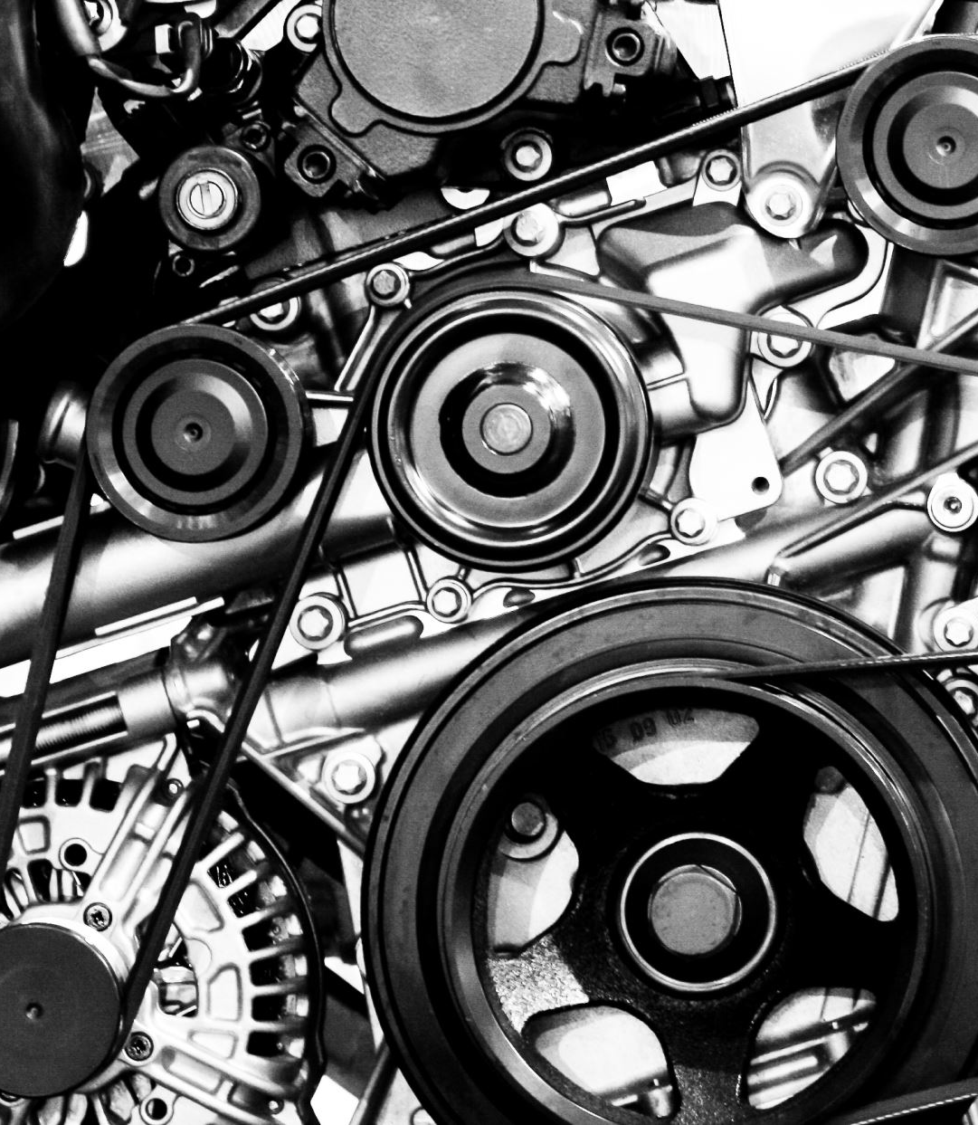
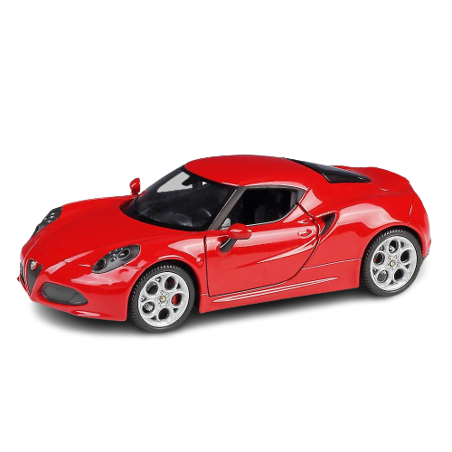
IMPACT OF CAR FEATURES

Slide 2
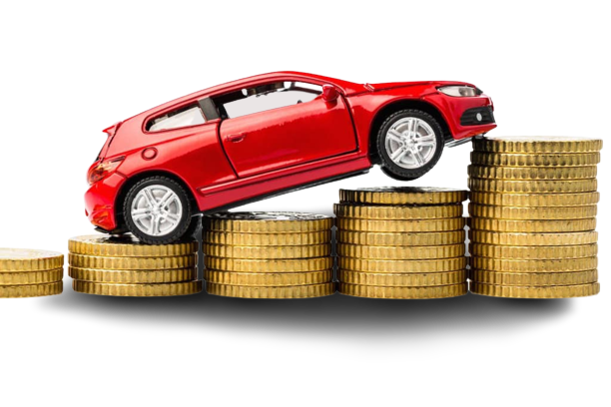
PROJECT DESCRIPTION
Objective:
This project aims to find how a car manufacturer can optimize pricing and product development decisions to maximize profitability while meeting consumer demand.
Dataset provided:
Rows - 11915
Columns - 16

Slide 3
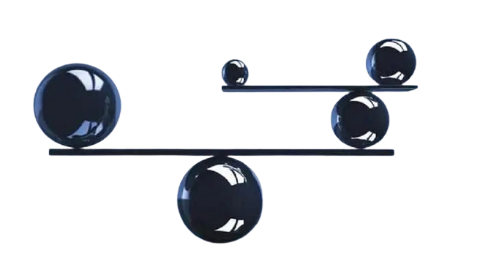
APPROACH
Understood the dataset provided
Performed all the given tasks in MS Excel
Created the presentation using MS PowerPoint
Created a video to present my presentation
Created a dashboard in Tableau

Slide 4


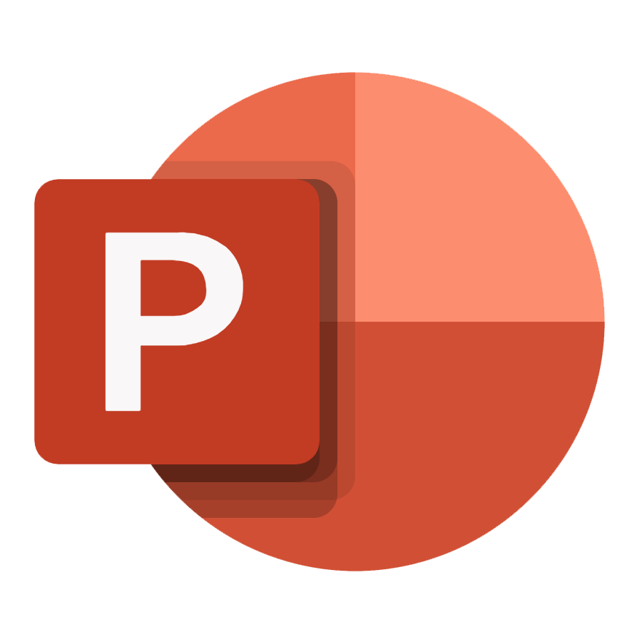
TECH-STACK USED
MS Excel (Microsoft 365 version):
Used to analyze the dataset provided to me.
Tableau:
Used to create the dashboard.
MS PowerPoint (Microsoft 365 version):
Used to create the presentation.

Slide 5
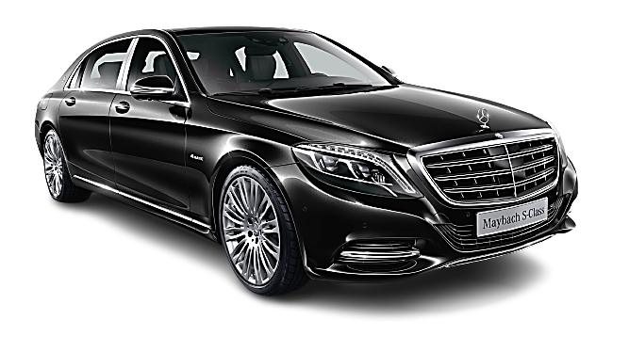
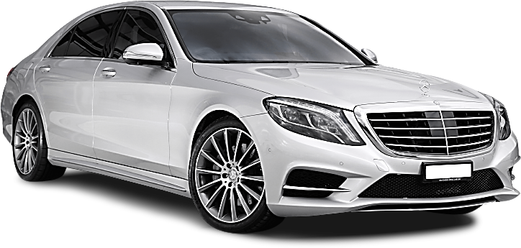
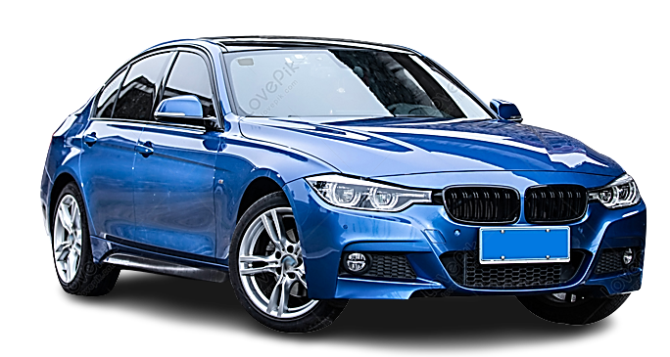
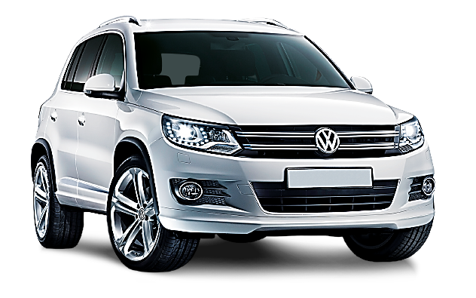
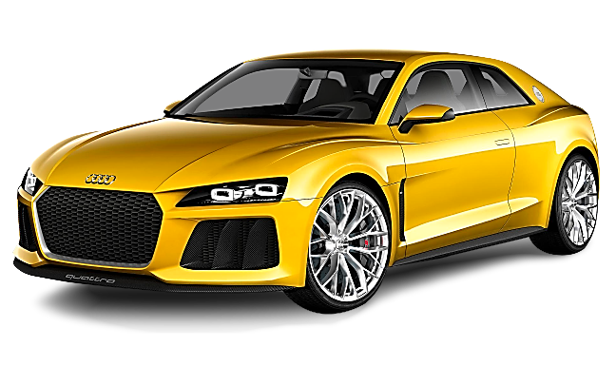
INSIGHTS
TASKS TO PERFORM IN EXCEL
How does the popularity of a car model vary across different market categories?
What is the relationship between a car's engine power and its price?
Which car features are most important in determining a car's price?
How does the average price of a car vary across different manufacturers?
What is the relationship between fuel efficiency and the number of cylinders in a car's engine?

Slide 6
INSIGHTS
TASKS TO PERFORM TO CREATE A DASHBOARD
How does the distribution of car prices vary by brand and body style?
Which car brands have the highest and lowest average MSRPs, and how does this vary by body style?
How do the different feature such as transmission type affect the MSRP, and how does this vary by body style?
How does the fuel efficiency of cars vary across different body styles and model years?
How does the car's horsepower, MPG, and price vary across different Brands?

Slide 7
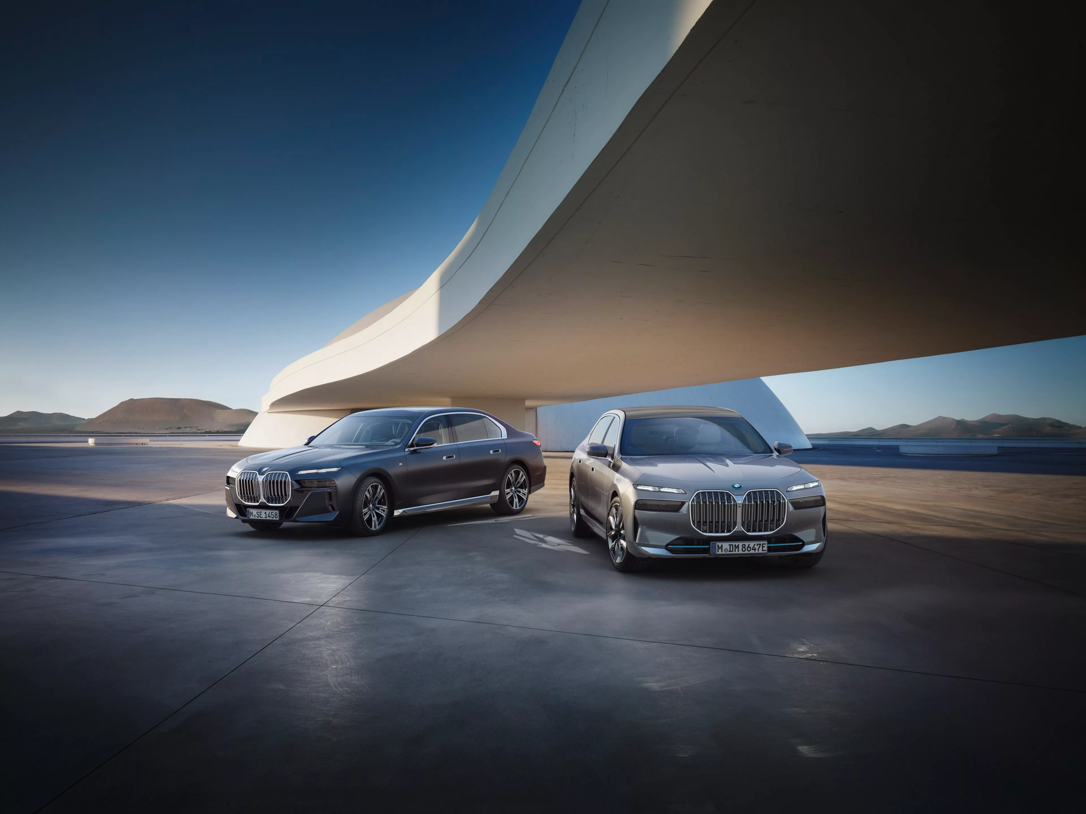
1
How does the popularity of a car model vary across different market categories?

Slide 8
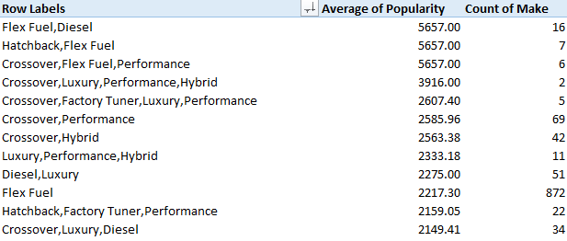
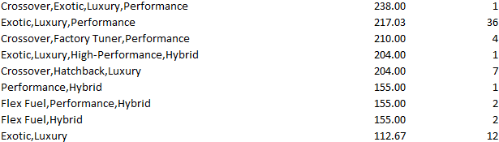
INSIGHTS
STEPS TO PERFORM
I created a pivot table with 3 columns.
Then by using the Power Pivot, I separated all the market categories.
After that, I created a combo chart that visualizes the relationship between market category and popularity.
.
.
.
INSIGHTS
Diesel cars have the highest popularity but have the lowest manufacture.
72 rows & 3 columns

Slide 9
INSIGHTS
Relationship between market category and popularity.

Slide 10
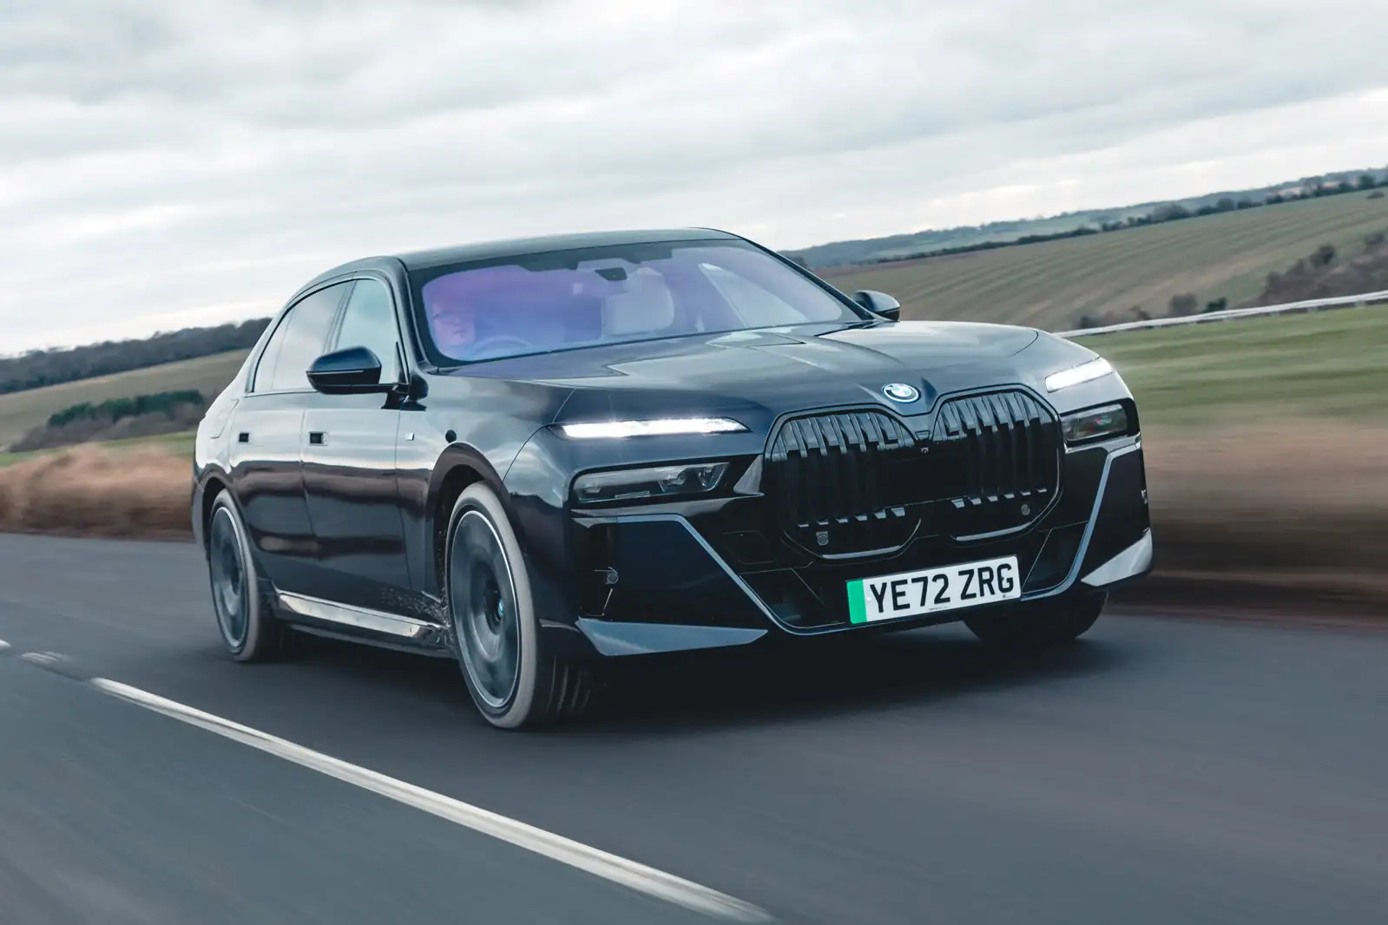
2
What is the relationship between a car's engine power and its price?

Slide 11
INSIGHTS
Relationship between car’s price and power of engine
STEPS TO PERFORM
I have created a scatter plot to show the relationship between the car’s price and the power of the engine.
INSIGHTS
When the power of the engine increases the price of the car also increases.

Slide 12
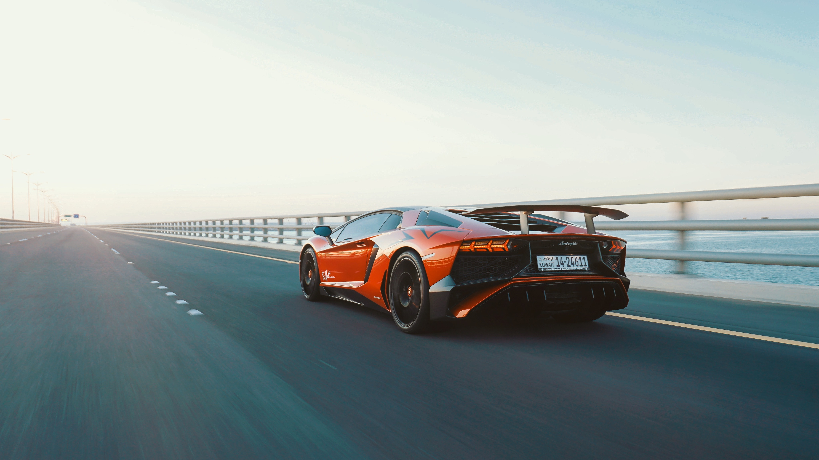
3
Which car features are most important in determining a car's price?

Slide 13
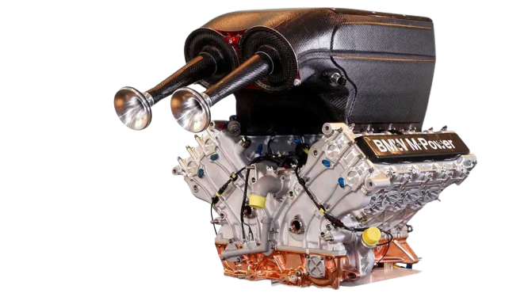
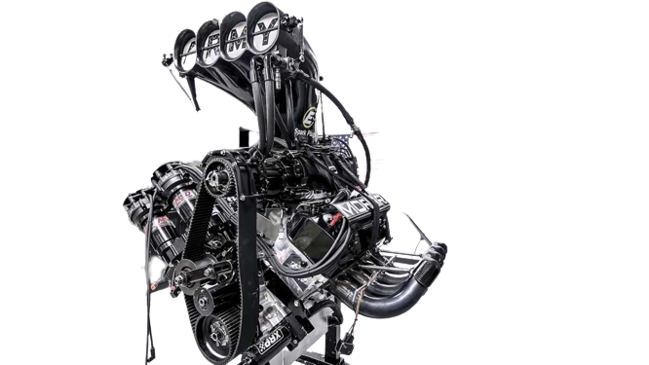
INSIGHTS
STEPS TO PERFORM
I have created 10 pivot tables to show the relationship with each feature.
And created 10 scatter plots to demonstrate each feature’s relationship with the price.
After that I created a bar graph to show which feature has a strong relationship with the price.
INSIGHTS
Transmission type, number of cylinders, and power of the engine are strongly responsible for the price of the car.

Slide 14
INSIGHTS

Slide 15
INSIGHTS

Slide 16
INSIGHTS

Slide 17
INSIGHTS
Relationship of different features of car with the price of car

Slide 18
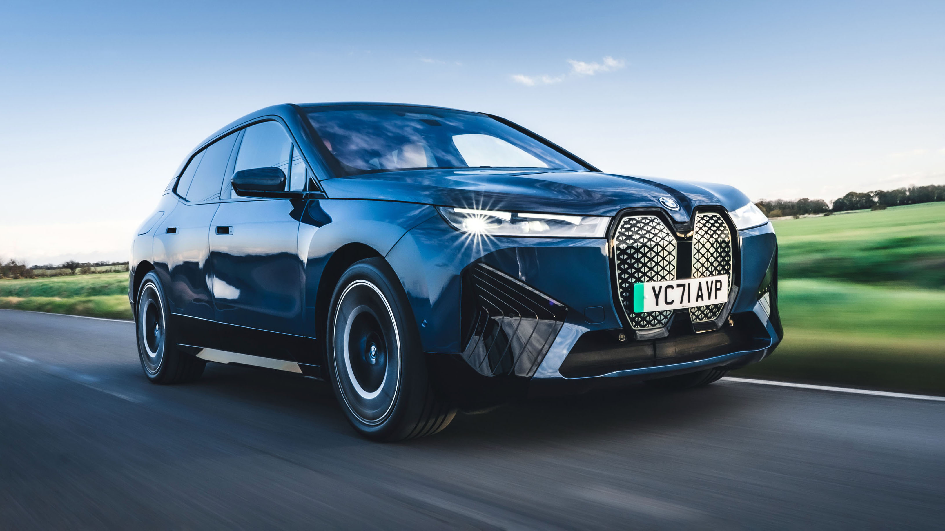
4
How does the average price of a car vary across different manufacturers?

Slide 19
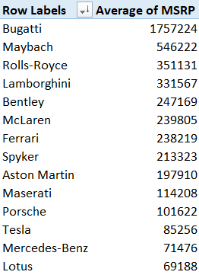
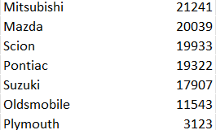
INSIGHTS
STEPS TO PERFORM
I have a pivot table that shows the manufacturer’s name with their respective average price of the car.
After that I created a bar chart to visualize the pivot table.
.
.
.
INSIGHTS
Bugatti, Maybach, Rolls-Royce, Lamborghini, and Bentley are the top manufacturers whose car average prices are the highest.
48 rows

Slide 20

INSIGHTS
Top manufactures with highest average MSRP

Slide 21
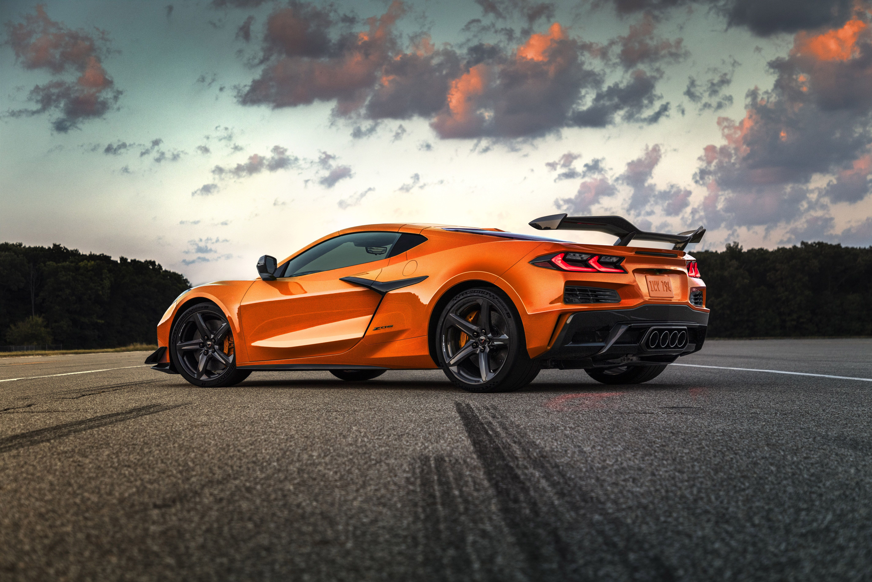
5
What is the relationship between fuel efficiency and the number of cylinders in a car's engine?

Slide 22
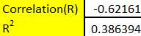
INSIGHTS
STEPS TO PERFORM
I have created a scatter plot for the number of cylinders in the y-axis and highway MPG in the x-axis to determine the relation between them.
INSIGHTS
There is a strong negative correlation between the number of cylinders and highway MPG which means as the number of cylinders increases highway MPG decreases.

Slide 23
DASHBOARD

Slide 24
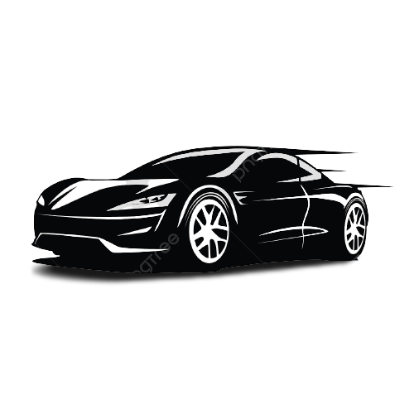
DASHBOARD
The dashboard contains –
2-line graphs – that shows the trend of fuel efficiency on highway and city.
1 clustered column chart – that shows the highest and lowest average MSRP that varies with vehicle style
1 stacked chart – that shows the distribution of car prices that vary by brand and body style
2 bubble charts – that shows engine HP, MSRP, and city MPG or highway MPG varying for different models
1 column chart – that shows transmission type affecting average MSRP
INSIGHTS
Vehicle style 4dr Hatchback’s fuel efficiency has gradually increased over time.
Bugatti has the highest average MSRP in the vehicle style coupe.
Automated manual cars with vehicle-style coupes and convertibles have the highest average MSRP.
Buggati Veyron 16.4 has the highest average engine HP with the highest price and the efficiency of the car is greater in the city as compared to the highway.
Chevrolet boasts the highest cumulative MSRP among all car brands.

Slide 25
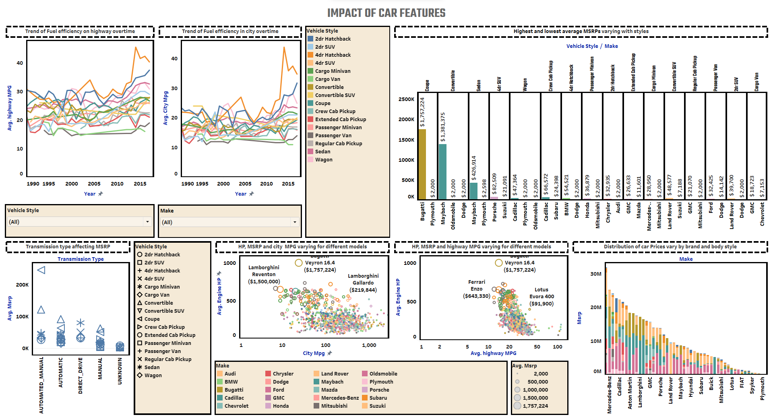

Slide 26
RESULT
In order to maximize profitability while meeting consumer demand, a car manufacturer should focus on optimizing pricing and product development decisions based on several key insights:
Fuel Efficiency Trends: Recognize the gradual increase in fuel efficiency for 4-door hatchbacks over time and consider incorporating these improvements into product development to align with consumer preferences for more fuel-efficient vehicles.
High-End Coupe Strategy: Acknowledge Bugatti's high average MSRP in the coupe vehicle style and explore opportunities to introduce premium coupe models to cater to luxury car enthusiasts.
Automated Manual Focus: Capitalize on the strong market demand for automated manual cars in coupe and convertible styles by offering innovative features and designs to justify higher average MSRPs.
Performance and Efficiency: Emulate the success of the Bugatti Veyron 16.4 by combining high engine horsepower with efficient city driving capabilities, potentially introducing more models with similar attributes.
Brand Value: Leverage Chevrolet's position as the brand with the highest cumulative MSRP to enhance brand value and potentially justify premium pricing for certain models.

Slide 27
RESULT
Cylinder Efficiency: Consider the strong negative correlation between the number of cylinders and highway MPG when designing engines, aiming for more efficient configurations.
Luxury Manufacturer Insights: Analyze top manufacturers like Bugatti, Maybach, Rolls-Royce, Lamborghini, and Bentley to identify pricing strategies and luxury features that resonate with consumers.
Factors Affecting Price: Understand that transmission type, number of cylinders, and engine power significantly impact car prices; optimize these factors in product development to align with target pricing.
Engine Power: Recognize the direct relationship between engine power and car price, potentially offering a range of power options to cater to various consumer segments.
Diesel Market Opportunity: Explore the potential of diesel cars, given their popularity among consumers despite lower manufacturing numbers, and consider offering innovative diesel models to tap into this market.
By incorporating these insights into pricing and product development decisions, a car manufacturer can position itself to meet consumer demands, drive profitability, and maintain a competitive edge in the dynamic automotive market

Slide 28
THANK YOU
Tableau Link: click here
Excel Link: click here

